Slide 1

Data Structures and Algorithms
(ES221)
AVL Trees
Dr. Zubair Ahmad

Slide 2
AVL Trees
Binary search trees with a large height/depth are inefficient.
An AVL (Adelson-Velskii and Landis) tree is a binary search tree with a balance condition.
The balance condition must be easy to maintain, and it ensures that the depth of the tree is O(log n).
An AVL tree is identical to a binary search tree, except that for every node in the tree, the height of the left and right subtrees can differ by at most 1.
The height of the left subtree minus the height of the right subtree of a node is called the balance of the node.
For an AVL tree, the balances of the nodes are always -1, 0 or 1.
5
4
6
3
7
2
8
1
9

Slide 3
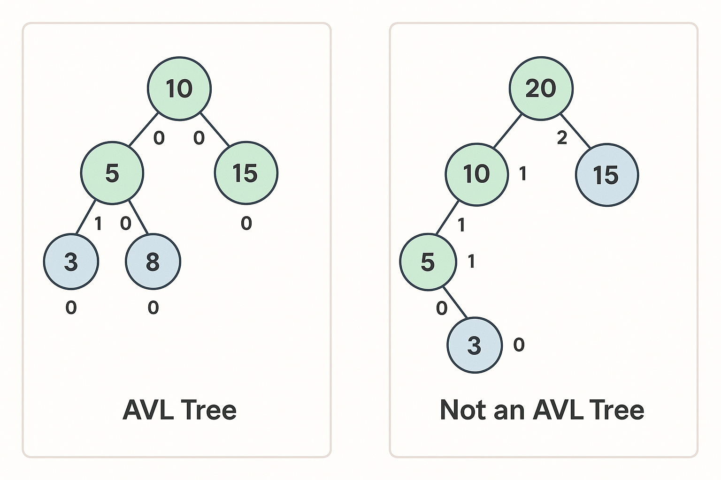
AVL - Trees

Slide 4
AVL - Trees
7
5
2
8
2
8
7
1
4
1
4
3
5
3
An AVL Tree
Not an AVL Tree

Slide 5
AVL Trees
When we do an insertion, we need to update all the balancing information for the nodes on the path back to the root
but the reason that insertion is potentially difficult is that inserting a node could violate the AVL tree property.
For instance, inserting 6 into the AVL tree in figure would destroy the balance condition at the node with key 8.
If this is the case, then the property has to be restored before the insertion step is considered over.
It turns out that this can always be done with a simple modification to the tree, known as a rotation.
5
2
8
7
1
4
6
3

Slide 6
AVL Trees
After the insertion/rotation operations, the following properties of the AVL tree must be restored
(a) the inorder traversal of the transformed tree is the same as for the original tree (i.e., the new tree remains a binary search tree)
(b) the tree after the insertion/rotation is height balanced.

Slide 7
AVL Trees
After an insertion, only nodes that are on the path from the insertion point to the root might have their balance altered
Follow the path up to the root, find the first node (i.e., deepest) whose new balance violates the AVL condition.
Call this node α
Rebalance the tree at node α
This guarantees that the entire tree is balanced.

Slide 8
AVL Trees
Violation may occur when an insertion into
1. left subtree of left child of α (LL case)
2. right subtree of left child of α (LR case)
3. left subtree of right child of α (RL case)
4. right subtree of right child of α (RR case)

Slide 9
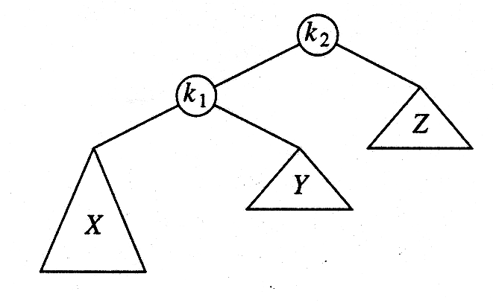
AVL Trees
Violation may occur when an insertion into
1. left subtree of left child of α (LL case)
4. right subtree of right child of α (RR case)
α
α
X
X
X

Slide 10
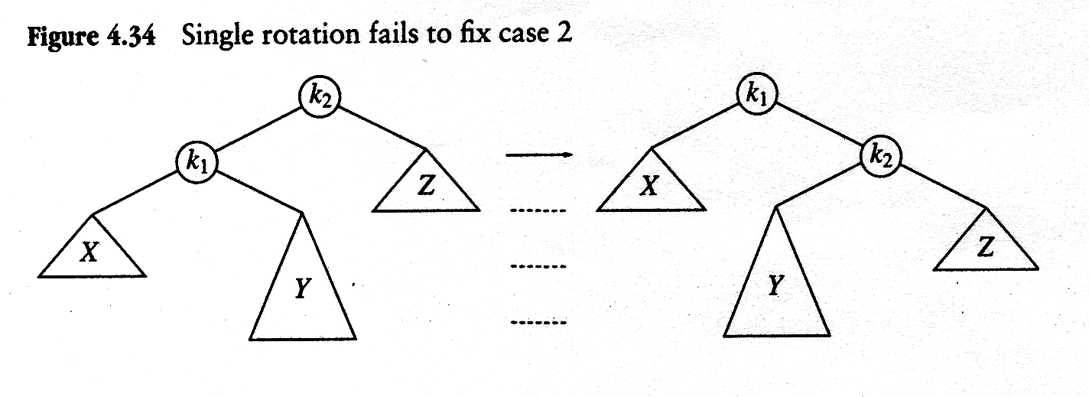
AVL Trees
Violation may occur when an insertion into
2. right subtree of left child of α (LR case)
3. left subtree of right child of a α (RL case)
α
α
X
X
X

Slide 11
AVL Trees
Rotation
to restore the AVL tree after insertion
Single rotation
for case 1 and 4
Double rotation
for case 2 and 3

Slide 12
AVL Trees
Single Rotation for case 1
k₂
k₂
k₁
k₁
k₁
Z
Z
k₂
Y
X
X
X
Y
Y
Z
Single Rotation for case 4
k₁
k₁
k₂
X
k₂
X
k₂
k₁
Y
Z
Y
Z
Z
X
Y

Slide 13
AVL Trees: Single Rotation
Example: 3 2 1 4 5 6 7
construct AVL Tree
3 2 1
3
3
2
2
1
1

Slide 14
AVL Trees: Single Rotation
Example: 3 2 1 4 5 6 7
construct AVL Tree
3 2 1
3
2
2
1
3
1

Slide 15
AVL Trees: Single Rotation
4 5
2
2
1
4
1
3
3
5
4
5

Slide 16
AVL Trees: Single Rotation
6
2
1
4
2
5
4
3
1
3
5
6
6

Slide 17
AVL Trees: Single Rotation
7
4
4
2
5
2
5
3
1
6
1
3
6
7
7

Slide 18
AVL Trees: Double Rotation
Single rotation fails to fix cases 2 and 3
i.e. LR and RL cases

Slide 19
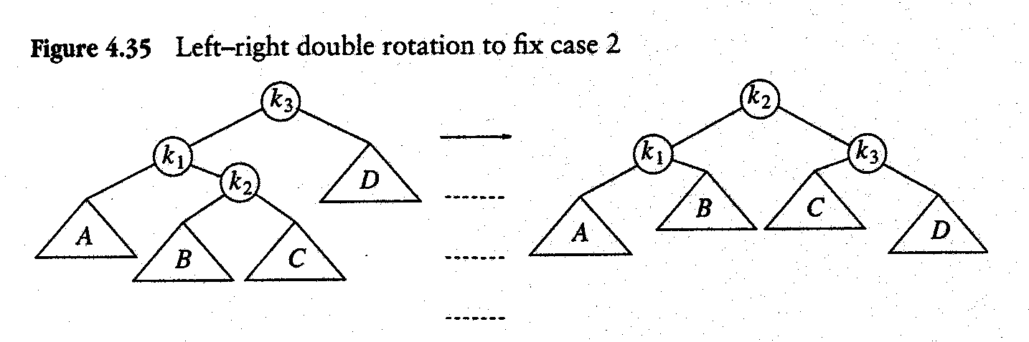
AVL Trees: Double Rotation
Double rotation is used
case 2 (LR case)
Step1: Rotate k₁ and k₂
Step2: Rotate k₂ and k₃

Slide 20
AVL Trees: Double Rotation
Double rotation is used
case 2 (LR case)
k₃
k₃
k₁
k₁
k₂
D
k₂
D
A
A
B
C
B
C
Step1: Rotate k₁ and k₂

Slide 21
AVL Trees: Double Rotation
Double rotation is used
Step 1: Single Rotation
k₁ and k₂ rotated
case 2 (LR case)
k₃
k₃
k₁
k₂
k₂
D
D
k₁
A
C
B
C
A
B
LR
LL
Step1: Rotate k₁ and k₂

Slide 22
AVL Trees: Double Rotation
Double rotation is used
Step 2: Single Rotation
k₃ and k₂ rotated
case 2 (LR case)
k₃
k₂
k₁
k₁
k₃
k₂
D
A
A
B
C
D
B
C
LR
Balanced
Step2: Rotate k₂ and k₃

Slide 23
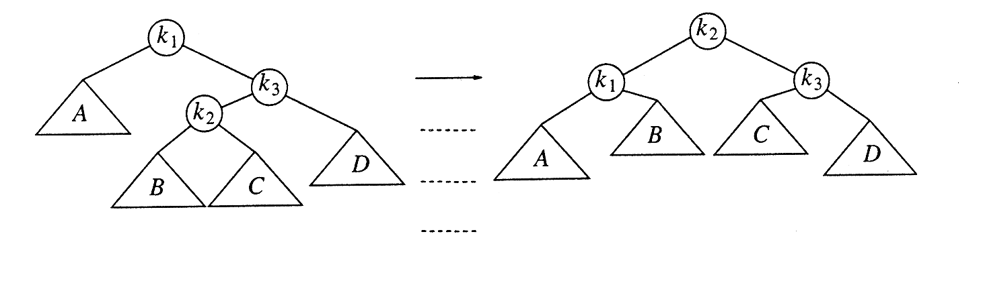
AVL Trees: Double Rotation
case 3 (RL case)
Step1: Rotate k₂ and k₃
Step2: Rotate k₁ and k₂

Slide 24
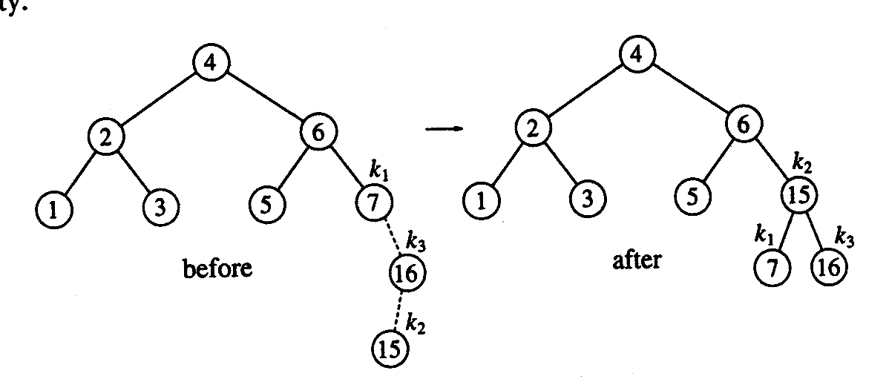
AVL Trees: Double Rotation
Example:

Slide 25
AVL Trees: Double Rotation
16 15
4
4
2
6
2
6
1
3
5
7
k₁
k₁
1
3
5
7
16
k₃
16
k₃
15
Double Rotation
Step 1: Rotate 15 and 16
15
k₂
k₂

Slide 26
AVL Trees: Double Rotation
16 15
4
4
2
6
2
6
1
3
5
7
k₁
k₁
1
3
5
7
16
k₃
15
k₂
15
Double Rotation
Step 2: Rotate 7 and 15
16
k₂
k₃

Slide 27
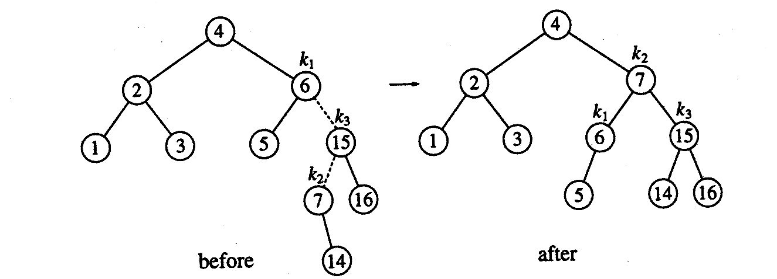
AVL Trees: Double Rotation
Insert 14
Step1: Rotate k₂ and k₃
Step2: Rotate k₁ and k₂

Slide 28
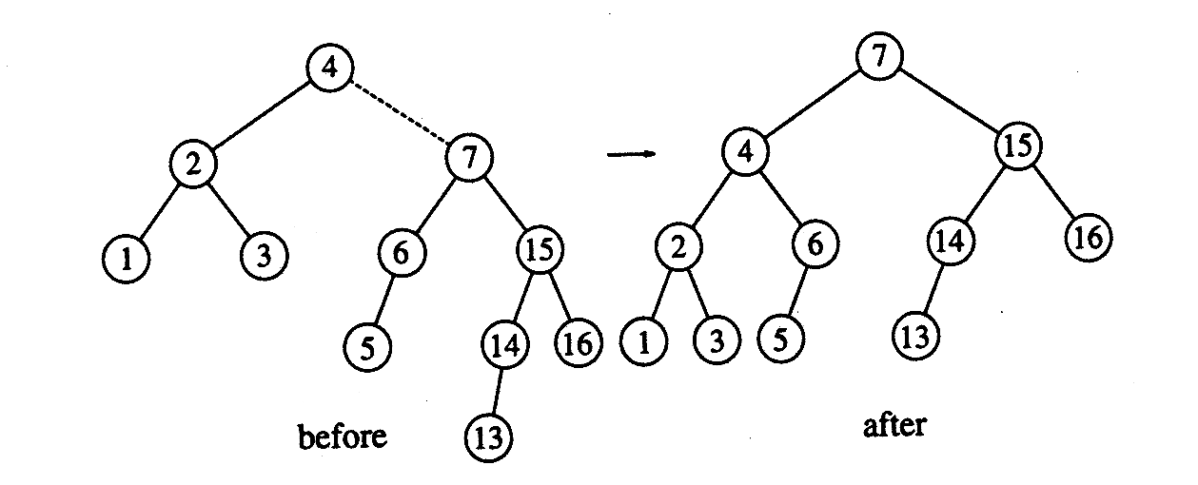
AVL Trees: Double Rotation
Insert 13 (This is single rotation: RR Case)

Slide 29
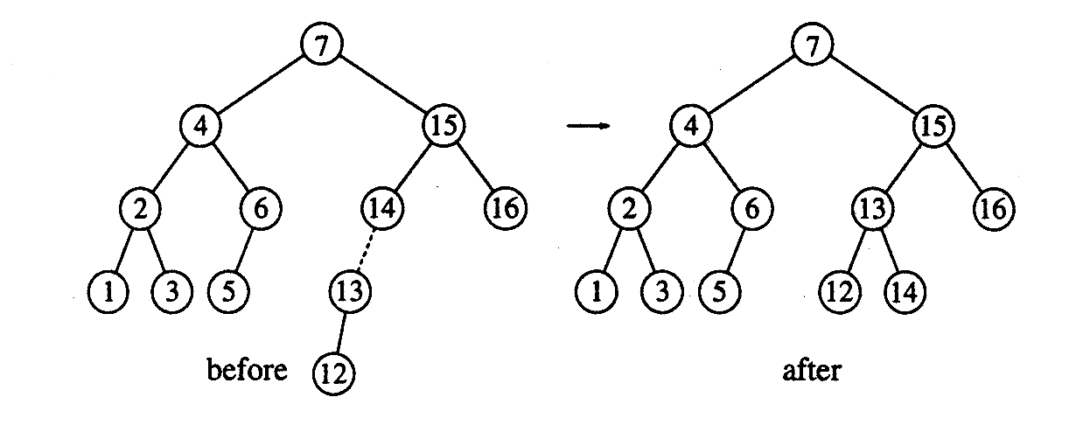
AVL Trees: Double Rotation
Insert 12

Slide 30
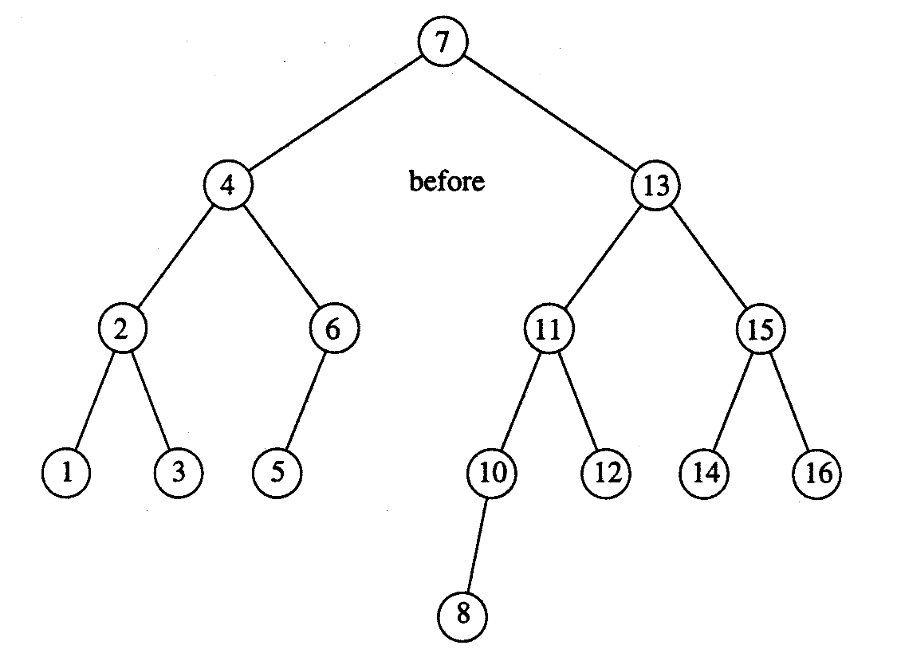
AVL Trees: Double Rotation
Insert 11 and 10 (single rotation), then 8

Slide 31
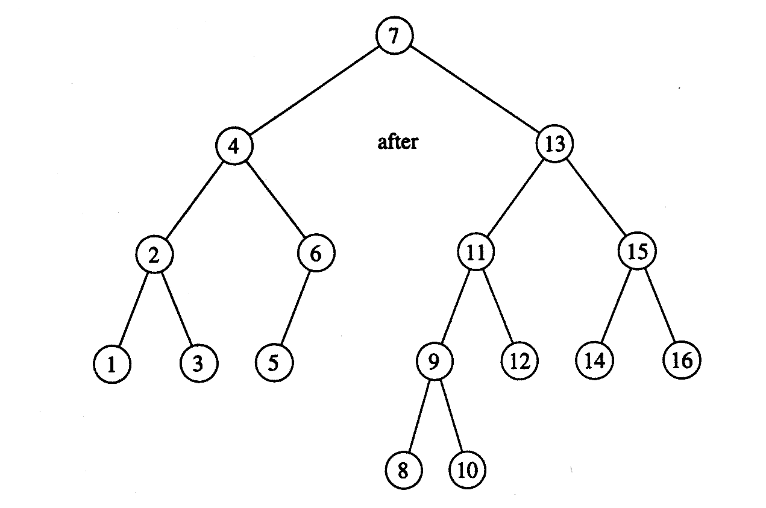
AVL Trees: Double Rotation
Inserting 9

Slide 32
Questions?
zahmaad.github.io

